Slide 1

DISPUTING A PPSR REGISTRATION – A PRACTICAL GUIDE
Presenter - Mark McKillop, Barrister
Presentation to the Leo Cussens Institute
Thursday, 23 September 2021
Contacts:
T 9225 7592
E mark.mckillop@vicbar.com.au
M 0402 891 370

Slide 2
Introduction
Please ask questions as we go
Basic Concepts Covered in this Seminar:
The administrative and judicial processes for disputing a PPSR Registration
The nature of the judicial process
Tips and Pitfalls

Slide 3
What is a PPSR REGISTRATION
Concepts
The Register:
Registrar of Personal Properties is obliged to establish and maintain the Register: s147(2) of the PPSA
A database of security interests affecting personal property.
Registration:
does not require a copy of the security agreement to be lodged.
records claims to security interests rather than interests per se
compare land or charge registers.
Notes:
What is a PPSR Registration
The Register: the Registrar of Personal Properties is obliged to establish and maintain the Register: s147(2) of the PPSA
The Register is a database owned by the Commonwealth.
Registration does not require a copy of the security agreement under which the security interest arises to be lodged.
Accordingly, the register records claims to security interests rather than a register of interests in personal property: compare land or charge registers.
A person applies to the Registrar to register a “financing statement” with respect to the security interest.
Whilst it is possible to attach up to 5 documents to a financing statement not exceeding 10MB in file size, in practice attachments are rarely used except where schedules of excepted property are needed in AllPAAP registrations with exceptions.
An application to register must be in the approved form and a lodgment fee paid. In practice the use of the correct form and payment of the fee are forced by the use of the online portal for registration which contains a drop down form to be populated by users.

Slide 4
What is a PPSR REGISTRATION/ 2
Concepts:
Guide – section 149
Register a “financing statement” to record the security interest in the register.
Register a “financing change statement” to subsequently alter the register
Notes:
What is a PPSR Registration
149 Guide to this Part
A person may apply to the Registrar to register a financing statement, or a financing change statement, with respect to a security interest or certain personal property.
A registration may perfect a security interest, which may give the secured party an advantage under this Act in enforcing the interest.
A person must not make an application with respect to a security interest unless the person believes on reasonable grounds that the security interest is, or will be, held by a person stated in the application to be a secured party.
A person applies to the Registrar to register a “financing statement” with respect to the security interest.
Changes are made to the register by lodging a financing change statement: see

Slide 5
Requirements to RegISTER
Do not need to be secured party
Duties of party applying to register:
      Must believe on reasonable grounds that person is or will become secured party in relation to collateral
      See s151(1) – civil penalty provision
      Applicant must remove registration within 5 business days via financing change statement if:
          the secured party has never been secured; or
          there are no longer reasonable grounds for belief that the secured party is secured
          See s151(2) – civil penalty provision
Notes:
Key Points
Don’t have to be a secured party: agent can do it, grantor can do it etc
Must believe:
On Reasonable grounds
Person is or will become secured party
Must remove – never or ceases to be secured

Slide 6
Obligation to remove registration and liability for loss
Persons with an interest in the subject personal property are taken to be owed the duties in 151(1) and (2) – s155(5)
Can sue for loss caused by breach of those duties: s271
No reported cases yet on s271 but it has been pleaded in several cases
Section 271 liability is in addition to other obligations at law or statute: s271(2)
Notes:
S151(5)
(5) For the purposes of section 271 (but without limiting that section):
(a) compliance with subsection (1) or (2) is taken to be an obligation imposed on a person who applies, or is required to apply, for the registration of a financing statement or a financing change statement; and
(b) any person with an interest in personal property described in the financing statement or financing change statement is taken to be a person to whom that obligation is owed; and
(c) a contravention of subsection (1) or (2) is taken to be a failure to discharge that obligation.
s271 Entitlement to damages for breach of duties or obligations
(1) If a person fails to discharge any duty or obligation imposed on the person by this Act:
(a) the person to whom the duty or obligation is owed; and
(b) any other person who can reasonably be expected to rely on performance of the duty or obligation;
has a right to recover damages for any loss or damage that was reasonably foreseeable as likely to result from the failure.
It is also essential that the Registrar should not believe that an application to register is frivolous, vexatious or offensive, or contrary to the public interest: s 150(3)(c).
In practice, the approved form is accessed and completed electronically and operates as a request for registration of either a financing statement or a financing change statement (which amends an existing registered financing statement). No effective policing by registrar.

Slide 7
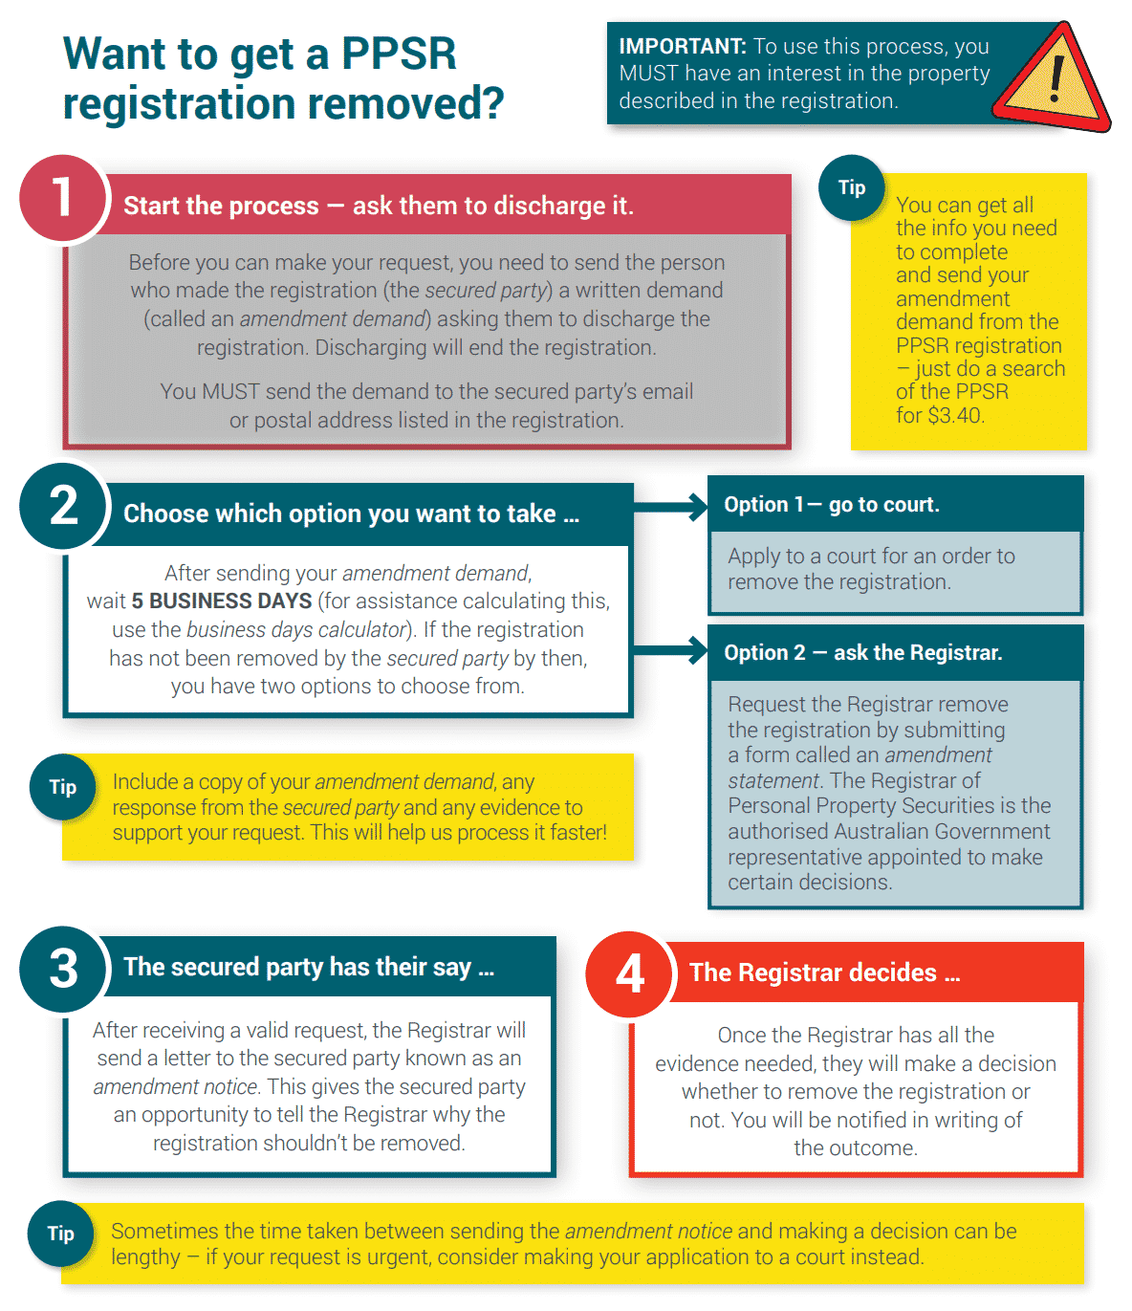
PROCESS TO REMOVE A REGISTRATION/1
FLOW CHART
Source: https://lawquarter.com.au/wp-content/uploads/2018/08/PPSR-image-1.png.webp
Notes:
Flow chart from lawquarter.com.au
Observations:
Start with amendment demand
Choose track:
Judicial
Administrative
This shows admin track

Slide 8
AMENDMENT DEMAND PROCESS – KEY REQUIREMENTs
See generally PPSA part 5.6
Threshold requirements:
Person giving demand must have an interest in the property described in the registration (including a security interest) – s178(1)
Giving of Amendment Demand activates the jurisdiction of the Registrar and the Judiciary to amend the register – s179(1) (administrative process), s182(1) (Judicial process)
Amendment Demand must adhere to the requirements of the PPSA
Amendment Demand requirements – 178(1).
For guidance see:
PPSR Registrar's Practice Statement no-4: Amendment Demands
PPSR Registrar's Practice Statement no-4A: Amendment Demands Tips
Notes:
https://www.ppsr.gov.au/about-us/laws-rules-and-regulations/ppsr-practice-statements/registrars-practice-statement-no-4

Slide 9
Form of amendment demand/1
Key Points:
Must be in writing;
Must be given to secured party;
Must demand a financing change statement be registered;
Must make a demand for one of two authorized purposes:
  To remove: no collateral secures any obligation owed by debtor to secured party
  To remove particular collateral: where the same in which the person has an interest does not secure any such obligation

Slide 10
Form of amendment demand/2
Required Elements of Demand:
  Date of demand
  Nature of Amendment Demanded and Basis for same:
      Removal outright
      Amendment to omit particular collateral
  Registration number of security interest
  Name of secured party
  Email and postal address for service of the secured party
  Name and contact details of the party giving demand
  If applicable (in search), the Giving of Notice Identifier
Notes:
Giving of notice identifier
Also known as GONI
This is your internal reference number that assists to identify your registration.
E.g your customer/client ID number, your account number or client reference number
As a secured party you can choose to enter a giving of notice identifier (GONI) on a PPSR registration which identifies a record of the registration for your secured party.
The giving of notice identifier, where it exists, must be included in correspondence to the secured party relating to that registration.
PERSONAL PROPERTY SECURITIES ACT 2009 - SECT 153
Financing statements with respect to security interests
(1) A financing statement with respect to a security interest (including such a financing statement as amended by the registration of a financing change statement) consists of data that complies with the following table:
...
3. Giving of notices. The following:
(a) an address (including an email address or fax number) for the giving of notices to the secured party (or secured parties) relating to the registration;
(b) details of any identifier provided for the giving of notices to the secured party (or secured parties).
Note: For identifiers, see section 289.
PERSONAL PROPERTY SECURITIES ACT 2009 - SECT 289
Notices etc. must be given to persons registered as secured parties using identifier
Despite anything in this Part, a notice or document is, for the purposes of this Act, taken not to have been given to a person registered as a secured party if:
(a) the Registrar approves a manner of including an identifier in a notice or document; and
(b) an identifier is specified in the registration for the giving of notices to the person; and
(c) the notice or document does not include the identifier in the manner approved by the Registrar.
PERSONAL PROPERTY SECURITIES ACT 2009 - SECT 292
Notices--formal defects
A notice purportedly given under this Act is not invalid as a result of a formal defect or an irregularity, unless:
(a) a person applies to a court objecting on that ground; and
(b) the court is satisfied that substantial injustice has been caused by the defect or irregularity; and
(c) the court is satisfied that the injustice cannot be remedied by an order of the court.

Slide 11
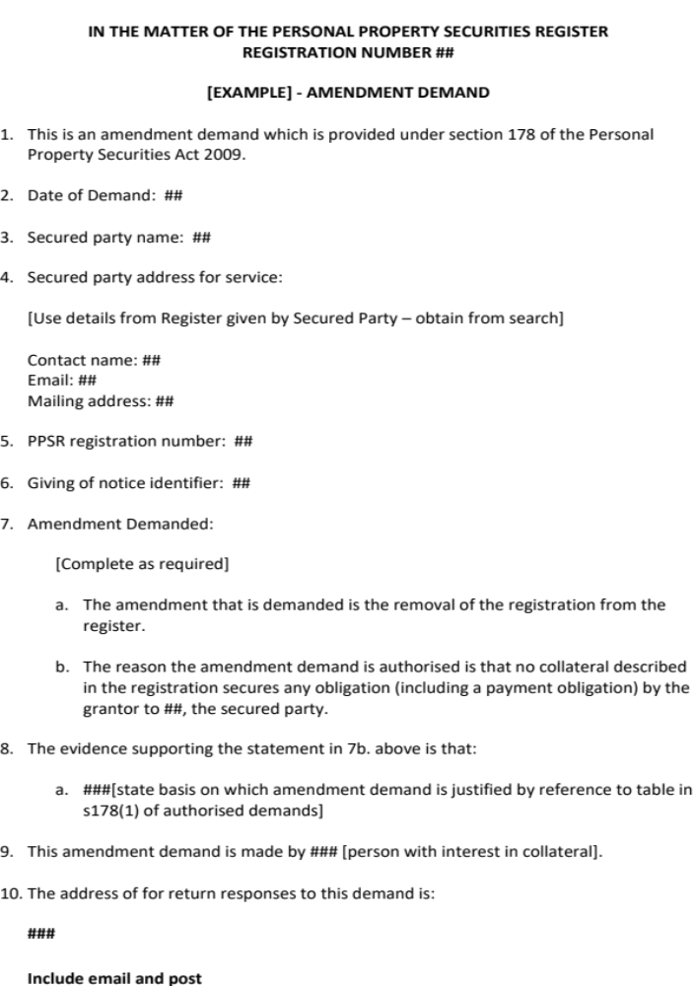
Form of AMENDMENT demand/3
Notes:
A sample from a recent matter
PPSR.gov.au has a sample to use at Registrars Practice Statement no 4A
https://www.ppsr.gov.au/about-us/laws-rules-and-regulations/ppsr-practice-statements/registrars-practice-statement-no-4a
See slide 2 above.

Slide 12
REMOVAL OF A REGISTRATION
Two options:
proceed with an administrative challenge
commence court proceedings.
Parallel, not sequential, paths
Judicial Process trumps the Administrative
Administrative process ceases to apply if judicial proceedings are commenced once it is invoked: s179(2)(b)
Thresholds:
Amendment demand in the proper form is sent to the secured party at its address for service
Must wait 5 business days before initiating either step
TIP:
There is no administrative or judicial jurisdiction if these requirements are not met.
Notes:
PERSONAL PROPERTY SECURITIES ACT 2009 - SECT 179
Scope of Subdivision
(1) This Subdivision applies if:
(a) a secured party is given an amendment demand; and
(b) an application has not been made to register a financing change statement in compliance with the demand before the end of 5 business days after the day the demand is given to the secured party; and
(c) there are no proceedings currently before a court (including a court of appeal), in relation to an application under section 182, that relate to the amendment demanded.
(2) This Subdivision stops applying if:
(a) a financing change statement is registered in accordance with the amendment demand; or
(b) proceedings come before a court (including a court of appeal), in relation to an application under section 182, that relate to the amendment demanded.
5 days: scope for s292 to cure:
PERSONAL PROPERTY SECURITIES ACT 2009 - SECT 292
Notices--formal defects
A notice purportedly given under this Act is not invalid as a result of a formal defect or an irregularity, unless:
(a) a person applies to a court objecting on that ground; and
(b) the court is satisfied that substantial injustice has been caused by the defect or irregularity; and
(c) the court is satisfied that the injustice cannot be remedied by an order of the court.

Slide 13
ADMINISTRATIVE PROCESS/1
Summary – apply to the Registrar to remove or amend the Registration
Threshold requirements: s179
Amendment Demand has been given to secured party
Application to register a financing change statement has not been made in response before the end of 5 business days
There are no court proceedings in relation to a judicial application under s182
Process
Submit a “Amendment Statement” to the Registrar:
Registrar sends “Amendment Notice” to the Secured Party
Secured Party has opportunity to respond
Registrar makes decision and notifies parties in writing.
Registrar's powers: s181:
register financing change statement unless suspect on reasonable grounds that amendment is not authorised.
Duty to consider response to amendment notice and any other relevant information
Notes:
181 Administrative process—registration amendments
(1) If an amendment notice is given to a secured party under section 180, after the end of the period covered by subsection (3), the Registrar must (at his or her initiative) register a financing change statement amending the registration (including an amendment to remove the registration) in accordance with the amendment demand, unless the Registrar suspects on reasonable grounds that the amendment is not authorised under section 178.
(2) However, the Registrar may register such a financing change statement before the end of the period covered by subsection (3) if:
(a) the secured party has responded to the invitation in the amendment notice; and
(b) the Registrar has no reason to believe that the secured party intends to give a further response.
(3) The period covered by this subsection is:
(a) 5 business days after the day the amendment notice is given to the secured party; or
(b) a longer period approved by the Registrar (in relation to the particular amendment demand, or to a class of amendment demands) after the amendment notice is given to the secured party.
(4) In making a decision about whether to register a financing change statement amending the registration in accordance with the amendment demand, the Registrar must consider:
(a) the response (if any) of the secured party to the invitation in the amendment notice; and
(b) any other relevant information.
(5) Data removed from the register because of an amendment under this section must not be made available for search in the register by reference to any time before (or after) the time of removal, if the Registrar so decides for the purposes of this subsection.
Note 1: The provision of false or misleading information in any response to the invitation may be an offence against Part 7.4 of the Criminal Code.
Note 2: The Registrar must give a verification statement to each secured party after the registration of a financing change statement (see section 156).
Note 3: Application may be made to the Administrative Appeals Tribunal for review of certain decisions of the Registrar about registration (see section 191).
Note 4: This section stops applying if proceedings come before a court under section 182 in relation to the amendment demanded (see subsection 179(2)).
Note 5: Incorrectly removed data may be restored under section 186.

Slide 14
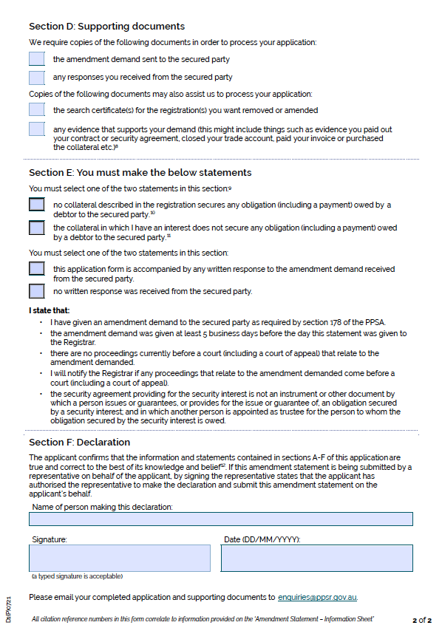
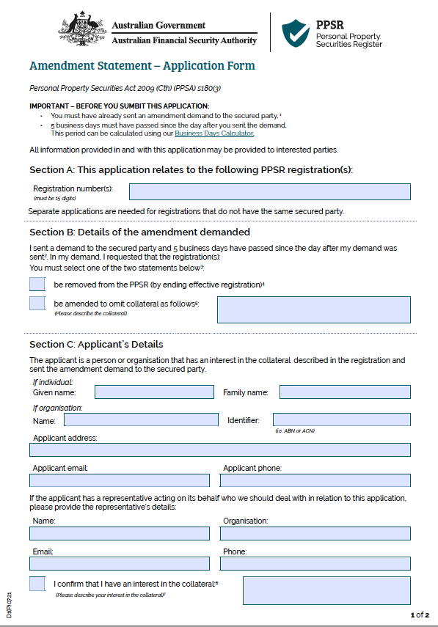
ADMINISTRATIVE PROCESS/2
  Content of an Amendment Statement:
  PDF Copy of Amendment Statement - PPSR.gov.au

Slide 15
ADMINISTRATIVE PROCESS/3
PROS AND CONS
Cons -
Slow: must wait for the Registrar to issue Amendment Notice, then wait for decision
Unreliable: Registrar has shown a reluctance to act even in obvious cases where amendment is justified if opposed:
Example: Curo Capital Pty Ltd v Registrar of Personal Property Securities [FCA] 1515
  Accidentally deleted data, Registrar refused to restore
  Per Jackson J:
  I consider that in refusing the application, the Registrar applied that policy inflexibly and without regard to the merits of the case on the basis of expressed opposition by two of the three grantors. Apart from the opposition expressed by Duc and Tien, the merits were all in favour of restoring the data. Even that opposition did not touch on the three registrations where the Society was grantor. And yet the Registrar refused to exercise the discretion in respect of all nine registrations. That was a failure to give proper, genuine and realistic consideration to the merits of the case: see Khan v Minister for Immigration and Ethnic Affairs [1987] FCA 457; (1987) 14 ALD 291 at 292 (Gummow J).

Slide 16
ADMINISTRATIVE PROCESS/4
Pros-
Cheap – appropriate where a lack of urgency and the case for removal or amendment is compelling or unopposed
Example: Everlyte Ltd and Registrar of Personal Property Securities [2020] AATA 2584
  Helicopter case
Notes:
Con
Everylte
Limited power – owner needed declaration of ownership and order for possession
Beyond the power of the Registar
Only a court can make such orders

Slide 17
JUDICIAL PROCESS/1
Summary – apply to the Court to remove or amend the Registration
Threshold requirements: s182
Secured Party or person giving demand can apply
Amendment Demand has been given to secured party
Cannot apply before the end of 5 business days after giving demand
A person with an interest in the collateral has the right to appear at the application eg owner in a lease
A Court: Federal Court, Federal Circuit Court, a Superior or lower court of a state or territory, Family Court – s207

Slide 18
JUDICIAL PROCESS/2
Process
Apply to the court
Court can order –s182(4):
  Registrar to register financing change statement if amendment authorised
  Restrain Registrar from so doing if not
  Restrain person who gave amendment demand from making further demands
  Restrain Registrar from giving further Amendment Notices
  Other orders as think fit
PPSA contains no power to restrain a person from making a registration, but the Court has inherent jurisdiction to make such an order:
Sandhurst Golf Estates Pty Ltd v Coppersmith Pty Ltd [2014] VSC 217; 285 FLR 267
Notes:
PERSONAL PROPERTY SECURITIES ACT 2009 - SECT 182
Judicial process for considering amendment demand
( 1) The following persons may apply to a court for an order in relation to an amendment demand:
(a) the secured party;
(b) the person who gave the amendment demand.
(2) The person who gave the amendment demand cannot make an application under this section before the end of 5 business days after the day the demand is given to the secured party.
Note: The period may be extended by a court under section 293.
(3) A person with an interest (including a security interest) in the collateral described in the registration has the right to appear before the court on an application under this section.
Note 1: The Registrar also has the power to intervene in the proceeding (see section 218).
Note 2: For which courts have jurisdiction, and for transfers between courts, see Part 6.2.
(4) On an application under this section, a court may make the following orders:
(a) if the court considers the amendment demanded to be authorised under section 178--an order requiring the Registrar to register a financing change statement amending the registration (including an amendment to remove the registration);
(b) if the court does not consider the amendment demanded to be so authorised--one or more of the following orders:
(i) an order restraining the Registrar from registering a financing change statement amending the registration at the Registrar's initiative (under section 181);
(ii) an order restraining the person who gave the amendment demand from making such further amendment demands as the court specifies;
(iii) an order restraining the Registrar from giving the secured party amendment notices under section 180 in relation to such further amendment demands as the court specifies;
(c) any other order that the court thinks fit.
(5) The Registrar must comply with a court order to register a financing change statement as soon as reasonably practicable after receiving the order.
Note: The Registrar must give a verification statement to each secured party after the registration of a financing change statement (see section 156).
(6) Data removed from the register because of an amendment under this section must not be made available for search in the register by reference to any time before (or after) the time of removal, if the Registrar so decides.
Note: Incorrectly removed data may be restored under section 186.
Sandhurst:
Elements required to get restraint:
From Rasco Pty Ltd v Lucas [2017] VSC 703 per McMillan J
A useful survey of the general principles applicable to the grant of quia timet injunctions was provided by Bennett J in Apotex Pty Ltd v Les Laboratories Servier (No 2), where her Honour noted:^{[61]}
The following principles generally apply to the grant of a quia timet injunction:
• A quia timet injunction is granted to prevent a threatened infringement of the rights of the applicant. The applicant must show that what the respondent is threatening and intending to do will cause imminent and substantial damage to the applicant.
• The word “imminent” means that the injunction must not be granted prematurely. The degree of probability of future injury is not an absolute standard. What is to be aimed at is justice between the parties, having regard to all the relevant circumstances. However, this is not to be taken as conveying that future injury need not be shown to be likely at all.
• Quia timet injunctions are not to be granted unless the imminence of the act to be prohibited is sufficiently clearly established to justify the court’s intervention.
• In deciding whether to grant a quia timet injunction, the court will have regard to the degree of probability of the apprehended injury, the degree of seriousness of the injury and the requirements of justice between the parties.

Slide 19
JUDICIAL PROCESS/3
Example Orders:
  The Court orders that:
  Pursuant to section 182(4) of the Personal Property Securities Act 2009 (Cth) the fourth defendant register a financing change statement removing the Registration number ## from the Personal Property Securities Register (PPSR).
  The First to Third Defendants are restrained from lodging any further financing statements on the PPSR in respect of ## (Collateral) without further order.
  If a registration is made on the PPSR in breach of Order 2, the Fourth Defendant [Registrar] is required to remove it forthwith.
  The Fourth Defendant is restrained from taking any step in respect of any amendment demand made by the first to third defendants in breach of Order 2.
Notes:
Some example cases:
Snowy Valleys Council v Anthony William Evans [2021] NSWSC 428
Nuisance case: rate payer claiming Council owes him debt. Chararcterises rate notices as debt istruments owing to him and registers on PPSR
On 2 October 2020, under the power provided by PPSA, s 150 Mr Evans applied as a secured party to register a financing statement with respect to a security interest in the PPS Register (PPS Registration No. 202010020035431). In the entry the Council is nominated as the grantor. The collateral type is “commercial property”. The commercial class is “negotiable instrument”. The description in the entry is “debt securities issued 10 June 2020” with a reference number being the same as the rate instalment notices.
In uncontested application Court applied s182(4) to remove and applied Sandhurst to restrain future registrations.
In the matter of Kimberley Diamonds Limited (in liquidation) [2021] NSWSC 865
Unopposed application by liquidator of Kimberley Diamonds to remove a registered security interest under s182.
Registration was for ALLPAAP but the security interest granted was limited to shares in a compaby Mantle. And proceeds of sale of those shares.
Liquidator sold shares in another company Alto andf sought directions as to disposal of proceeds.
Orders made.
Query – why even make this application. Registration is not determinative of existence of SI , only underlying security agreements are: see para [10] quoting Auburn Shopping Village.
No priority dispute here, Seems a wasted application.
Explicable if the applicant was itself a secured party and doubt as to whether the respondent was: subject to payment priorities under section 140 of the PPSA:
140 Distribution of proceeds received by secured party
Scope
(1) This section applies if any amount, personal property or proceeds (within the ordinary meaning of that term) of collateral is received by or on behalf of a secured party as a result of enforcing a security interest in collateral (whether or not under section 120 or 128).
(1A) This section does not prevent the operation of another law of the Commonwealth, or a law of a State or Territory, to the extent that the law requires the amount, personal property or proceeds to be applied towards one or more obligations to persons that do not hold security interests (or any other interests) in the collateral before being applied towards any (or all) of the obligations mentioned in subsection (2).
Example: This section does not prevent the operation of section 561 of the Corporations Act 2001, which gives priority to the satisfaction of certain unsecured obligations over the claims of a secured party holding a circulating security interest in a debtor’s property.
Order of application
(2) The amount, personal property or proceeds must be applied in the following order:
(a) obligations to persons holding interests (other than security interests) in the collateral that have a higher priority (whether under this Act or otherwise) than the interest of the secured party;
Note: The interests referred to in this paragraph might be interests to which this Act would otherwise not apply (see subsection 8(2)).
(b) reasonable expenses incurred in relation to the enforcement of security interests against the collateral, to the extent that the expenses are secured by the security interests;
Note: Reasonable expenses in relation to the enforcement of a security interest are taken to be secured by the security interest unless the parties agree otherwise (see subsection 18(5)).
(c) obligations to persons holding security interests in the collateral that have a higher priority (whether under this Act or otherwise) than the interest of the secured party;
(d) obligations to the secured party that are secured by the security interest in the collateral;
(e) obligations to persons holding interests or security interests in the collateral that have a lower priority (whether under this Act or otherwise) than the interest of the secured party;
(f) to the grantor.
R.G. Murch Nominees Pty Ltd v Paul David Annesley [2019] VSC 107
Unopposed application at final hearing
Security interest claimed in land: PPSA does not apply.
Claimant could not identify any security agreement when pressed - nuisance registration
Court did not grant continuing injunction to restrain lodgment of future caveats: not sufficient evidence that Annesley was threatening to register in the future. Had a history of lodging nuisance caveats but not

Slide 20
JUDICIAL PROCESS/4
Pros and Cons
Expensive: Will usually require at least one, and probably two appearances in Court and the cost of supporting and reply affidavits
Fast: can be brought on quickly in a practice or duty court
Similar but not the same as caveat removal application:
Process has been liken to an application to remove a caveat and can be brought on very rapidly. See Toyota Finance NZ Ltd v Christie [2009] NZHC 827 cited in Wickham Hill Investment Pty Ltd v Ding [2019] NSWSC 631
Person seeking to remove registration must establish a prima facie case that the amendment is authorised. See National Australia Bank Ltd v Garrett [2016] FCA 714; 340 ALR 532 at [33]. It is then for the person seeking to maintain registration to show a serious question to be tried or arguable case.

Slide 21
Thank You
Contact:
Mark McKillop, Barrister at Law
of Castan Chambers Level 14, 460 Lonsdale Street, Melbourne
Clerk: Foley’s List
Telephone 9225 7592
Email mark.mckillop@vicbar.com.au
Mobile 0402 891 370

