Slide 1

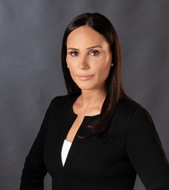
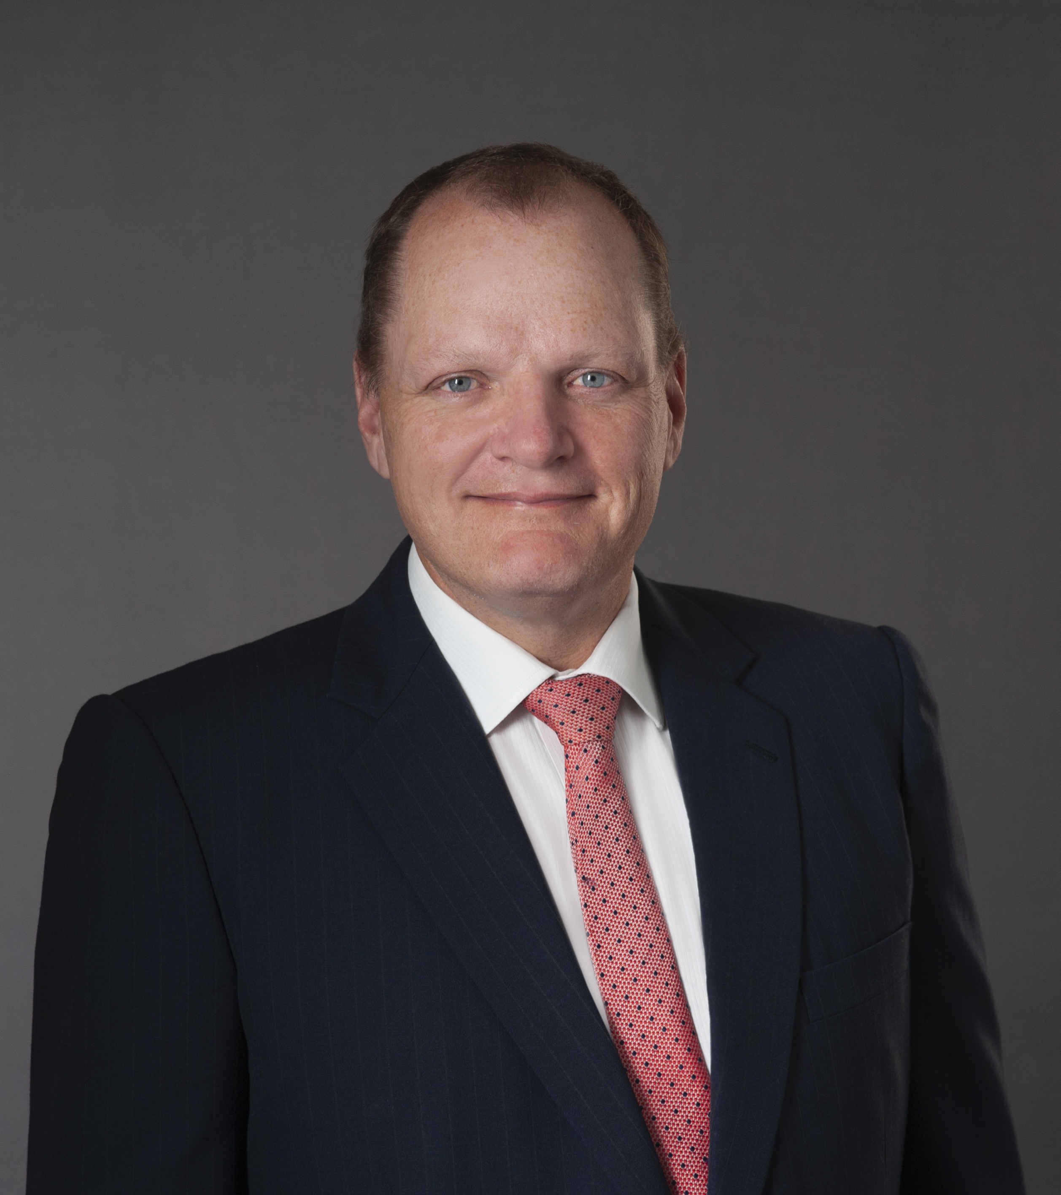
Mediation best practice: strategies to get the best results out of a mediation
Contact:
Michelle Button
T 9225 7777
E michelle.button@vicbar.com.au
M 0413 309 809
Presenters - Mark McKillop and Michelle Button, Barristers, NATIONALLY ACCREDITED MEDIATORS
Presentation to the Geelong Law Association
Friday 28 October 2022
Contact:
Mark McKillop
T 9225 7592
E mark.mckillop@vicbar.com.au
M 0402 891 370

Slide 2

Introduction
Please ask questions, or participate, as we go.
Basic Concepts Covered in this Seminar:
We assume familiarity with the Mediation Process
We will discuss some tools that you can use to improve your mediation results

Slide 3
THE PURPOSE OF MEDIATION
A structured negotiation
To resolve a dispute
Need not be limited to the dispute subject of litigation
Contrast to litigation – adversarial vs mutual negotiation

Slide 4
THE USUAL TOOLs
“THE ROUTINE”
Position Papers
Open Session
Breakout rooms
Conventional Price Negotiation
Terms of Settlement
What are some others?
How can we improve the use of these tools

Slide 5
POSITION PAPERS
ROUTINE:
Recites the Claim Or Defence
No concessions
IMPROVED:
Assume the parties and mediator know the claim and defence
Focus on the three or four points on which the dispute turns, to emphasize risk
Make realistic assessments: constructive approach

Slide 6

POSITION PAPERS/2
Best alternative to not agreeing: “BATNA”
Analyze the alternatives to settling: know your “BATNA” and that of your opponent
Why is it in your opponent's interest to settle? Constructive approach
Set out the full costs of going to trial:
interest and legals
Time, better spent elsewhere
Stress
Reputation risk

Slide 7
OPEN SESSIONS
ROUTINE:
Mediator speaks
Lawyers outline claims
Parties break to their rooms
IMPROVED:
Is an open session advisable?
Could the clients speak?
Taking turns
Getting off the chest

Slide 8
OPEN SESSIONS/2
Some tools:
Empathy (vs confrontation)
Discussion to explore and learn
Exploring alternatives
Can we negotiate exist outside the litigation?
Non monetary items that might be offered:
Values/Face
Timing
Confidentiality
Non money items
Further opportunities

Slide 9
Open Sessions/3
Emotion is an important context of the dispute
Commercial, Family, or even a neighbourhood dispute.
Gather certain information from the parties as part of the pre- mediation intake process. This intake assessment will help to limit the issues in dispute, educate the parties about the process which could hopefully lead to an earlier resolution.
Opening Statements are important. People in conflict need at least 8- 10 min to settle down in a room with each other. Even on Zoom. Builds confidence in the process and rapport.
Have your client come prepared with some dot points that they would like to mention should they have the chance to speak. Makes it a dialogue between the parties. This is after all, their mediation.
To facilitate a meaningful conversation. Take the responsibility off yourself- it is for the parties to come to the agreement. Manage the time and the process. The agreement is not yours to reach- it is theirs.

Slide 10
Open Sessions/4
Reading and responding to emotion
Body language is important.
Move your chair back- lean back in the chair and let the participants talk to each other. Being with the client physically and psychologically and making them feel heard.
Indicating that the speaker is being understood and followed.
Parties need to be heard and acknowledged before they can move from a position or emotive situation.
Acknowledging the facts is easy and most people can do this. What is important in mediation is the acknowledging of the ‘feelings, emotions, or intention’ underpinning those facts.

Slide 11
Negotiation
ROUTINE:
Inching toward a settlement
I made the last offer
IMPROVED:
Anchoring
Framing
Offering items not available in litigation:
Non money items as above
Security
Timing: immediate payment, money over time
Compromise cash flows: royalty example.

Slide 12
Micro skills
Micro Skills that are important:
Listening
Acknowledging
Reframing
Summarising
Questioning

Slide 13
Micro skills/2
Active listening seems easy on the face of it, but to be truly present in the moment, blocking out all other thoughts and avoiding making plans or answers in your own head to what is being can be challenging.
Gain a repertoire of skills and phrases that can be used during each mediation.
Reframing/ summarising the subject matter if it is quite complex will also require certain skill.
As a facilitative mediator, the mediator may not have any prior knowledge of the subject matter or area of the mediation, whereas the participants will have intricate knowledge of what is being discussed.
Some examples of things that may go astray............

Slide 14

TErMS OF SETTLEMENT
ROUTINE:
Prepared once a deal is done.
Boilerplate
Lengthy recitals
Risk that deal does not get done on the day

Slide 15
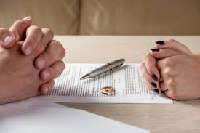
TErMS OF SETTLEMENT/2
Improved:
Have terms ready before the day
Prepare with this matter in mind, not boilerplate: triggers consideration
Avoid long recitals
Keep as simple as possible: no more than a few key clauses:
Settlement sum
Non-monetary settlement clauses
Releases
Discontinuance
Confidentiality (if required)
Default
Get terms signed on the day
Present with first round of negotiations (if appropriate) [Framing]

Slide 16
Thank You
Contact:
Mark McKillop, Barrister at Law, Nationally Accredited Mediator
of Castan Chambers Level 14, 460 Lonsdale Street, Melbourne
T 9225 7592
E mark.mckillop@vicbar.com.au
M 0402 891 370
Contact:
Michelle Button, Barrister at Law, Nationally Accredited Mediator
of Gorman Chambers Level 9, 460 Lonsdale Street, Melbourne
T 9225 7777
E michelle.button@vicbar.com.au
M 0413 309 809

