Slide 2

PPSA ISSUES INVOLVING HIGH VALUE PLANT, EQUIPMENT AND COLLATERAL
Mark McKillop, Barrister

Slide 3
Four Cases
Kirkalocka Gold SPV Pty Ltd (Receivers and Managers Appointed) v Zenith Pacific (KLK) Pty Ltd [2024] FCA 428
Re Qenos Pty Ltd (administrators appointed) [2024] NSWSC 483
Bluewaters Power 1 Pty Ltd v The Griffin Coal Mining Company Pty Ltd [2019] WASC 438
Forge Group Power Pty Limited (in liquidation) (receivers and managers appointed) v General Electric International Inc [2016] NSWSC 52

Slide 4
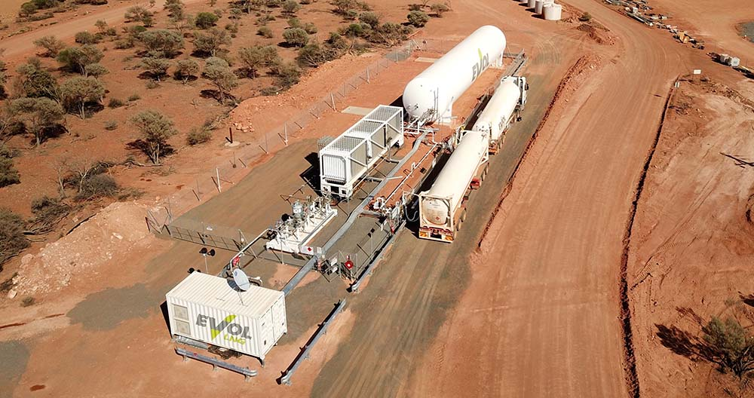
Kirkalocka
$8.27m LNG/Diesel Power Plant

Slide 5
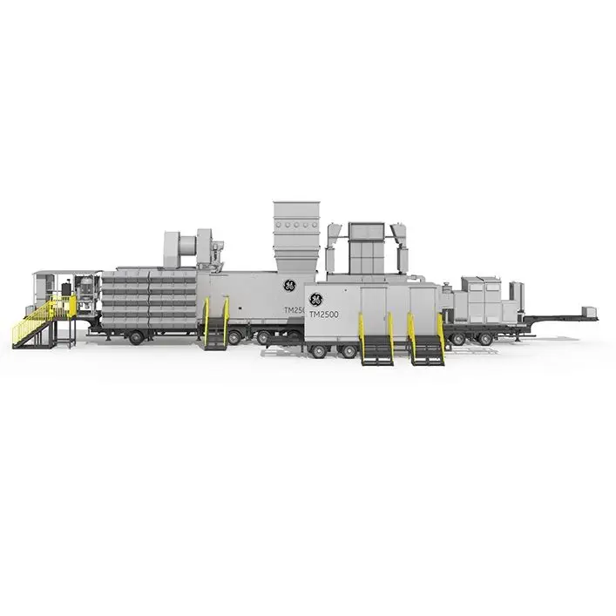
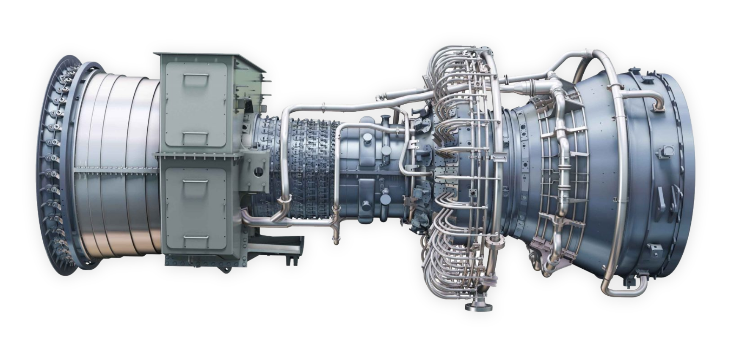
Forge
4 Gas Turbine sets @USD12-15M each

Slide 6

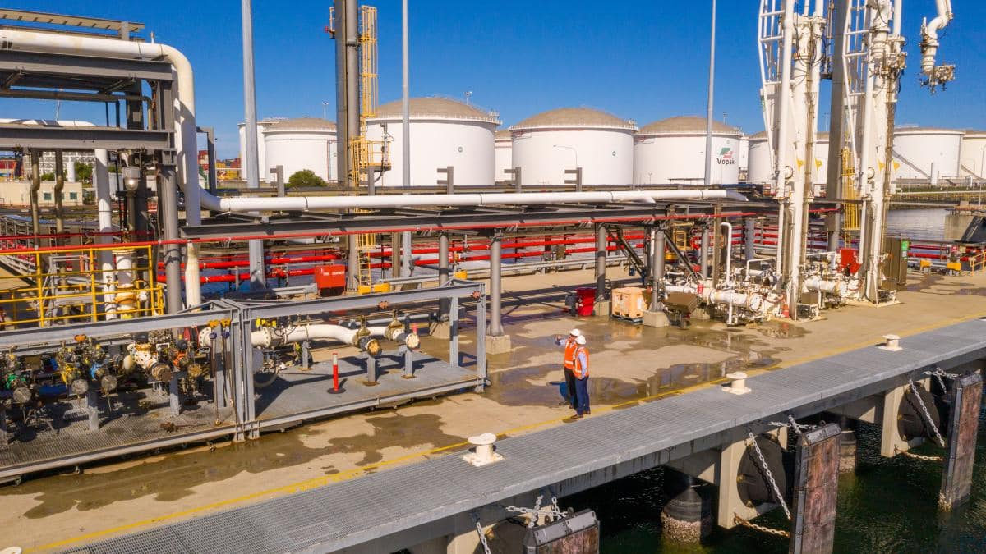
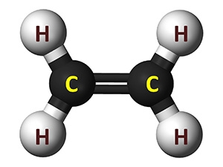

QENOS - $5,215,168.27 of Ethylene

Slide 7
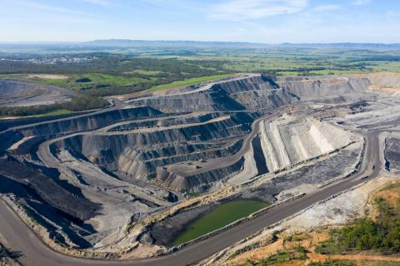
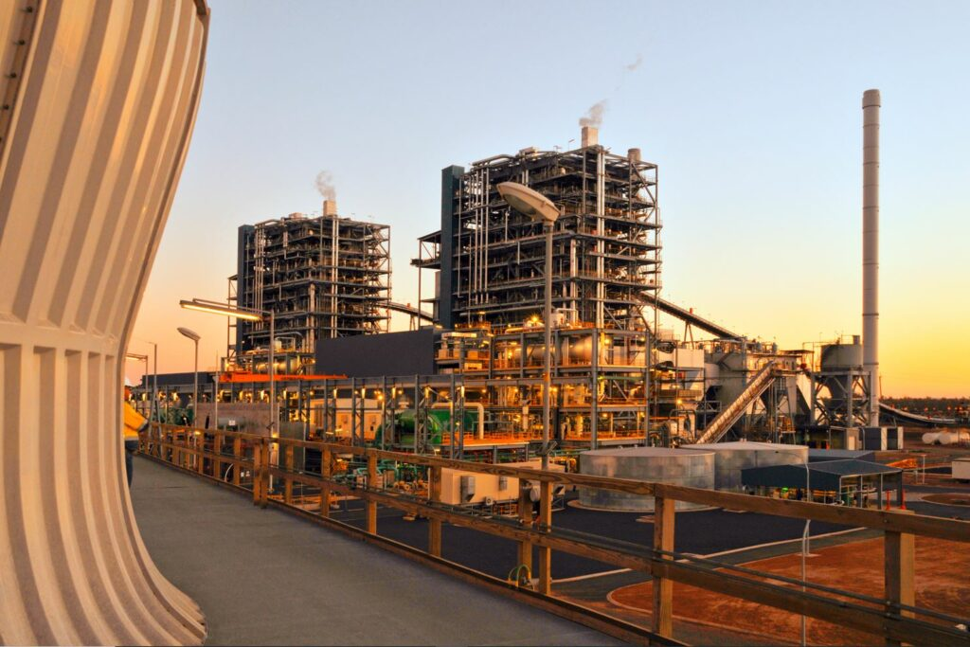
Bluewaters Power – a big coal mine
2023 - $220M subsidy to keep it operating
pending “wind/solar/battery” replacements in the future

Slide 8
Some Concepts
Security Interest
Consensual
Secures payment or
obligation
Without regard to form
In substance
Deemed Security interests
s12(1) “security interest means an interest in personal property provided for by a transaction that, in substance, secures payment or performance of an obligation (without regard to the form of the transaction or the identity of the person who has title to the property).”
Notes:
What is a security interest?
A security interest secures payment of a debt or other obligation regardless of the form of the transaction.
The definition for a security interest is set out at s12.
covers a range of transactions some of which would historically have been covered by a clear and intentional security, like a charge or a chattel mortgage, and also other securities which perhaps weren’t considered to be a formal security. Some examples are:
Retention of title clauses in sale agreements whereby a purchaser has possession of personal property, but does not acquire title from the vendor until the full purchase price is paid.
Financing leases where personal property is leased for payments that cover the cost of the personal property and the lessee has the ability to acquire title to the personal property.
Consignment agreements.
Whether a specific debt is secured can be opaque.
The Corporations Act does not define “unsecured debt” however other terms are, such as “secured creditor”, “security interest” and so forth, at sections 51 to 51F.
All that is required, is:
A transaction – some consensual arrangement;
Which gives rise to an interest in personal property; and
Which secures payment or performance of some other obligation.

Slide 9
Concepts Cont…
  PPS lease - “Deemed Security Interest”
  s13
  Lease or bailment of goods for more than 2 years or indefinite term
    Serial numbered goods-term of 90 days or more or indefinite term
    Lessor or bailor must be in the business of leasing or bailing goods-s13(2)
      Only bailments for reward (not gratuitous)-s13(3)
  Security Interest regardless of form

Slide 10
CASE STUDIES

Slide 11
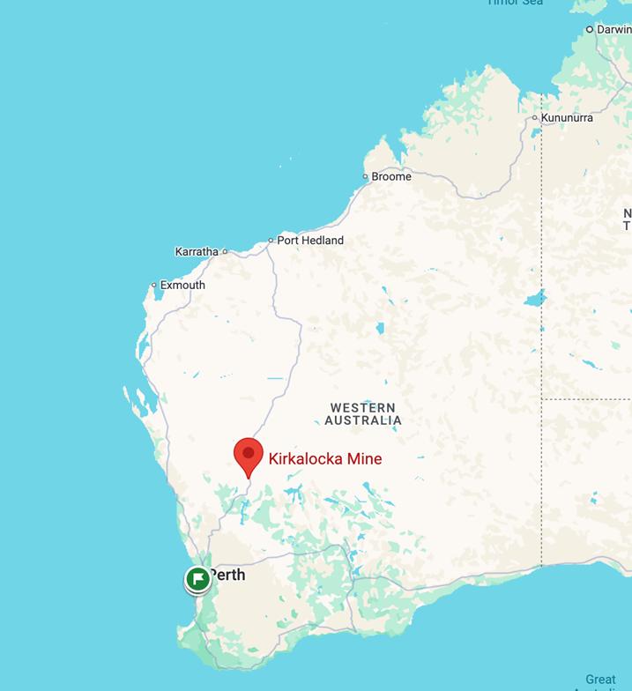
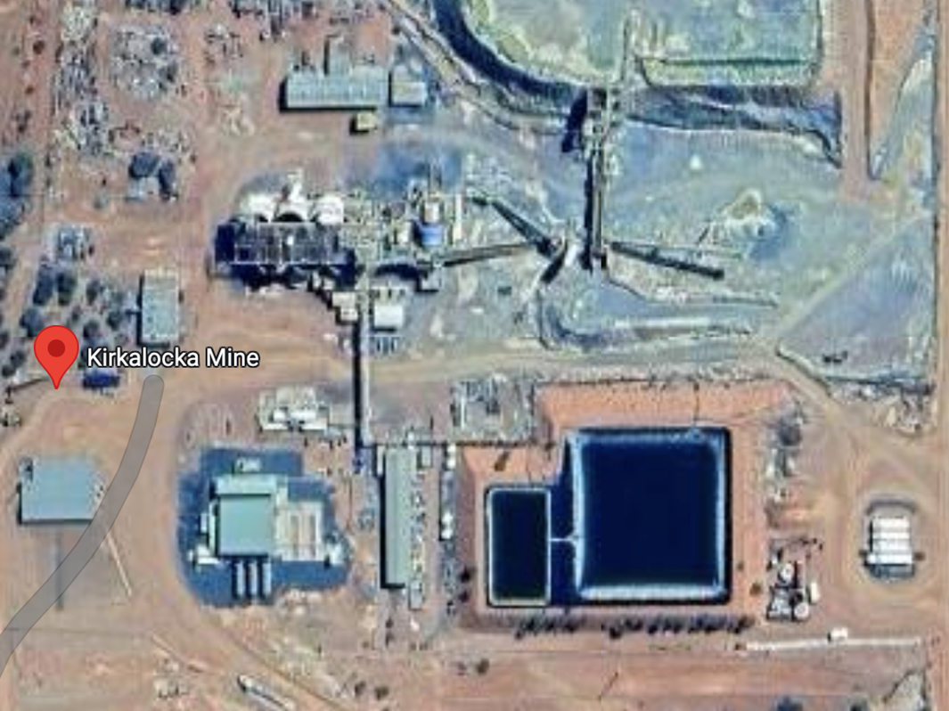
Kirkalocka Gold SPV Pty Ltd (Receivers and Managers Appointed) v Zenith Pacific (KLK) Pty Ltd, in the matter of Kirkalocka Gold SPV Pty Ltd [2024] FCA 428

Slide 12
Kirkalocka Gold SPV Pty Ltd (Receivers and Managers Appointed) v Zenith Pacific (KLK) Pty Ltd, in the matter of Kirkalocka Gold SPV Pty Ltd [2024] FCA 428
Failure to Register is not Fatal when you are in possession
Facts:
Kirkalocka operated a mine in WA. The mine had an onsite power plant. Zenith had a contract to operate and maintain the power plant and supply power to Kirkalocka.
Not a fixture: personal property subject to the PPSA.
Zenith had not registered its interest under the supply contract in the power plant.
Kirkalocka went into VA and into receivership.

Slide 13
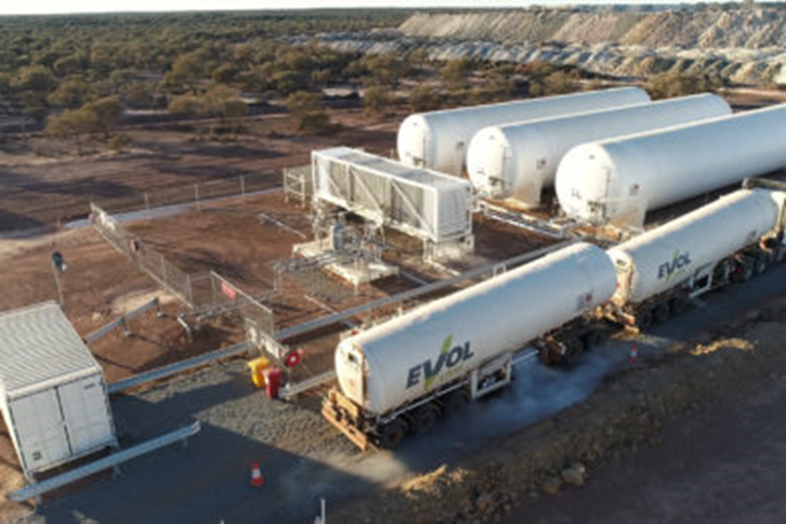
Kirkalocka Gold SPV Pty Ltd (Receivers and Managers Appointed) v Zenith Pacific (KLK) Pty Ltd, in the matter of Kirkalocka Gold SPV Pty Ltd [2024] FCA 428
Issues:
whether the power plant had vested in Kirkalocka on the VA’s appointment. The claim was brought by the receiver.
There were two main sub issues:
  Did Zenith have a security interest in the power plant that required perfection?
  If yes, was Zenith in possession, so that its security interest would be perfected and the interest would not vest in Kirkalocka

Slide 14
Kirkalocka Gold SPV Pty Ltd (Receivers and Managers Appointed) v Zenith Pacific (KLK) Pty Ltd, in the matter of Kirkalocka Gold SPV Pty Ltd [2024] FCA 428
Findings: Security Interest
Zenith did have a security interest:
  It had maintained title, so there was no question that ownership if the equipment had transferred to Kirkalocka so that it could grant an interest in the equipment back to Zenith
    Ie – no vendor finance
  However, on the expiry of the 10 year term, Kirkalocka would have paid off the bulk of the value of the power plant and would have a contractual right to purchase it. The right would be lost on default.
  There was no transfer of title at the end of the term, so no in substance security interest – finance lease
  It was a BOO(T) agreement: Zenith maintained possession of the equipment.
    So no bailment of the power plant, no PPS Lease

Slide 15
Kirkalocka Gold SPV Pty Ltd (Receivers and Managers Appointed) v Zenith Pacific (KLK) Pty Ltd, in the matter of Kirkalocka Gold SPV Pty Ltd [2024] FCA 428
Nevertheless the Court (not in an entirely convincing way) found a security interest still existed
BESANKO J:
75. The question then comes down to whether the fact that at all times Zenith retained possession of the Zenith Power Plant means that it did not have a security interest within s 12(1) of the PPSA. I have given this matter anxious consideration. I was not referred to any authority directly on the point. I have concluded that possession or not, s 12(1) is wide enough to cover a situation such as the present, particularly where Kirkalocka by the end of the term, and assuming no early termination, would have paid off a substantial proportion of the value of the Zenith Power Plant and possibly more.
76. Zenith’s interest in personal property is the legal interest with a retention of title clause which can be engaged should Kirkalocka not perform its obligations under the PPA, including its obligation to make payment of the Capacity Charges and the Energy Charges.

Slide 16
Kirkalocka Gold SPV Pty Ltd (Receivers and Managers Appointed) v Zenith Pacific (KLK) Pty Ltd, in the matter of Kirkalocka Gold SPV Pty Ltd [2024] FCA 428
Findings – Perfection by Possession
Zenith had perfected by possession of its security interest by maintaining possession.
On the construction of the Power Purchase Agreement Zenith maintained possession:
Zenith was contractually obliged to supply, install, operate and maintain the power plant;
The contract reserved title to Zenith other than by exercise of a purchase option exercisable at year 10;
Kirkalocka was granted access to the power plant but only for limited purposes – viz purposes agreed between the parties, and to access the circuit breakers and isolators by trained personnel;
Kirkalocka had a step in right, which implied Zenith had possession;
The fact that Kirkalocka controlled the overall mine site was not determinative;
Outcome - Zenith had a perfected security interest by means of possession and accordingly prevailed over the receiver, since it had been in possession at the appointment of the VA.

Slide 17
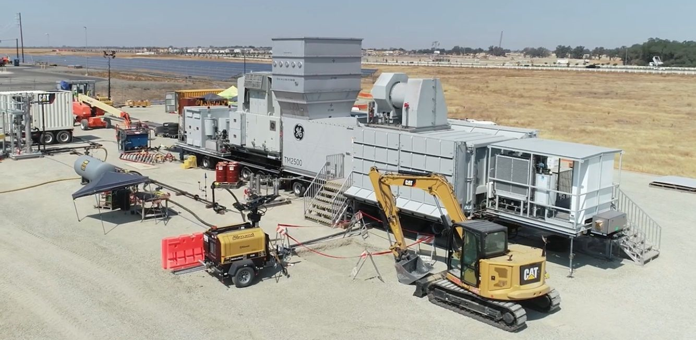
Forge Group Power Pty Limited (in liquidation)(receivers and managers appointed) v General Electric International Inc [2016] NSWSC 52; 11 BFRA 50

Slide 18
Forge Group Power Pty Limited (in liquidation)(receivers and managers appointed) v General Electric International Inc [2016] NSWSC 52; 11 BFRA 50
The 4 turbine sets were part of a temporary power station established by Regional Power Corporation (Horizon Power).
No registration
Issue 1 – PPS Lease?
The rental arrangement was a PPS Lease: it was
The lease was found to be a PPS lease because it met the criteria set out in s 13(1) of the PPSA, which includes leases of goods for a term of more than one year or for an indefinite term
The court found that General Electric International Inc (GE) was regularly engaged in the business of leasing goods within Australia when the lease was entered into, which meant that the exclusion from the definition of "PPS lease" in s 13(2)(a) of the Personal Property Securities Act 2009 (Cth) (PPSA) was not engaged

Slide 19
Forge Group Power Pty Limited (in liquidation)(receivers and managers appointed) v General Electric International Inc [2016] NSWSC 52; 11 BFRA 50
Issue 2: Fixtures
Section 8(1)(j)
The PPSA does not apply to an interest in a fixture .
Section 10:
"fixtures” means goods, other than crops, that are affixed to land.
Common law concept of fixture applies.

Slide 20
Forge Group Power Pty Limited (in liquidation)(receivers and managers appointed) v General Electric International Inc [2016] NSWSC 52; 11 BFRA 50
Issue 2: Fixtures?
The turbines were, or were not, fixtures (and so not subject to the PPSA): they weren’t
The turbines were designed to be demobilised and moved to another site easily and in a short time, indicating a temporary purpose for their installation
The mode of attachment was intended to be reversible, with the turbines and associated equipment designed to be reusable once disconnected from the power station
The attachment of the turbines to the land was for the better enjoyment of the turbines themselves, not for the better enjoyment of the land, and their removal would cause minimal damage to the land
The contractual terms specified that the turbines would remain personal property and not become part of the land, reinforcing the intention that they were not to be considered fixtures
The court found that the turbines did not become fixtures and that the lease was a PPS lease, resulting in the applicant liquidator's right or title to the turbines being superior to that of the respondents

Slide 21

In the matter of Qenos Pty Ltd (administrators appointed) [2024] NSWSC 483
PPS Leases and
Bailments

Slide 22
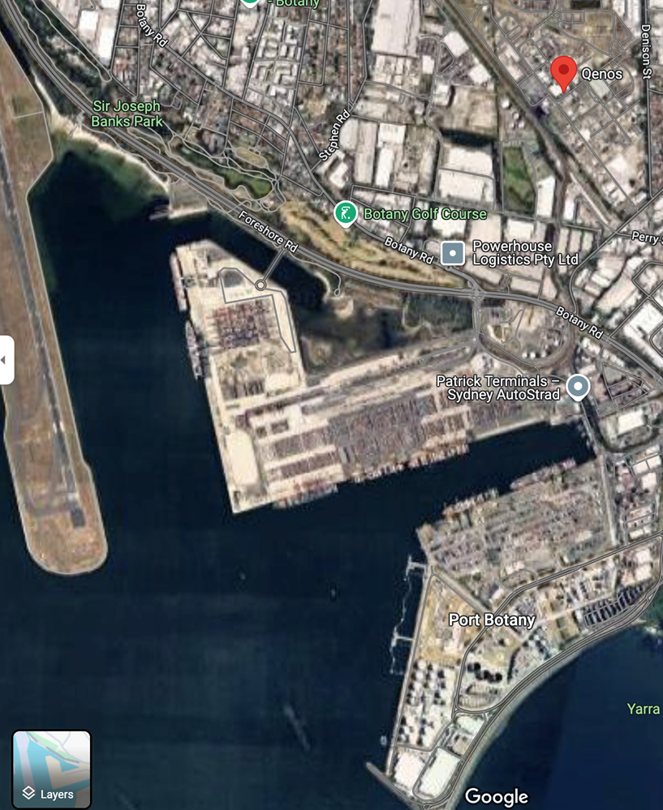

In the matter of Qenos Pty Ltd (administrators appointed) [2024] NSWSC 483

Slide 23
In the matter of Qenos Pty Ltd (administrators appointed) [2024] NSWSC 483
Facts:
Qenos operated a plastics and chemical manufacturing business with plants at, among other places, in the Port of Botany in Sydney.
Qenos went into VA on 17 April 2024.
The plaintiff, Indorama, had 2,800 metric tonnes of ethylene stored in a storage tank at Qenos’ Botany site on the appointment of the VA. The ethylene had been imported by ship.
In ordinary circumstances, the liquid ethylene would be provided in gas form to Indorama upon offloading to the shore through a pipeline. In this case, the ethylene was stored at the terminal due to an occurrence of a shut down at the plant for technical reasons.
The VA claimed that the ethylene had vested in Qenos on their appointment by reason of s267 of the PPSA.
Issues:
Was the bailment of the ethylene to Qenos a PPS Lease?

Slide 24
In the matter of Qenos Pty Ltd (administrators appointed) [2024] NSWSC 483
Outcome: it wasn’t
The ethylene was bailed to Qenos, but not to secure any debt or obligation to perform. The bailment was a storage arrangement for which Qenos was not paid a fee.
Accordingly, there was no PPS Lease:
  The bailment was not for value – Qenos did not pay Indorama for possession or use of the chemical;
  Processing of the chemical into gaseous form did not amount to provision of value, since that step was required to deliver the ethylene from liquid form when stored;
  Indorama was not in the business of bailing goods
  The bailment was not for a term of 2 years or more, or for shorter terms that could be extended by an option.

Slide 25
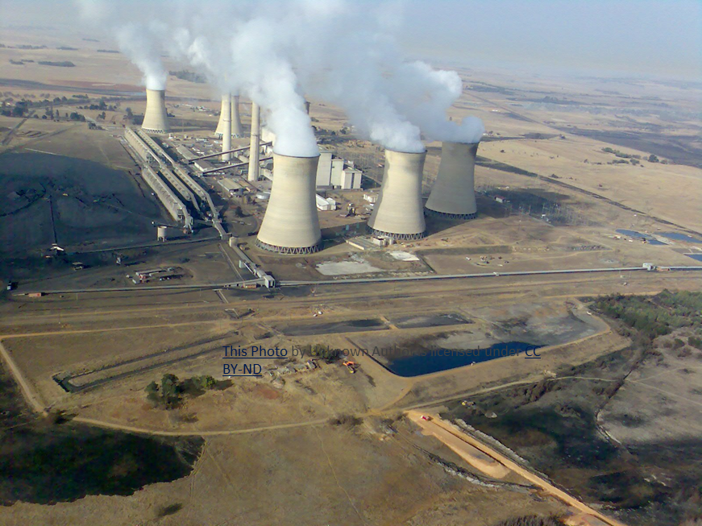
Bluewaters Power 1 Pty Ltd v The Griffin Coal Mining Company Pty Ltd [2019] WASC 438
Demonstrating how wide a
security interest can be:
the case of step in rights
Notes:
Bluewaters Power 1 Pty Ltd v The Griffin Coal Mining Company Pty Ltd
[2019] WASC 438 (Bluewaters)
“Demonstrating how wide a security interest can be: the case of step in rights”
This case is an interesting demonstration of the wide meaning of “security interest”.
The plaintiff companies (Bluewaters Power) operate a coal fired power station in Collie, WA. The coal to feed the station is sourced from an adjacent coal mine, operated by the defendant (Griffin Coal).
In the past, Bluewaters Power had been a wholly owned subsidiary of Griffin Coal. It ceased to be shortly after Griffin Coal went into administration in 2010. As a consequence, the coal supply agreements between Griffin Coal and Bluewaters Power were amended to introduce “step in rights” in favour of Bluewaters Power.
In substance, these rights entitle Bluewaters Power to take over the operation of the coal mine should the supply of coal be adversely affected in certain defined circumstances. On the occurrence of a “step in event”, Bluewaters Power can elect to enter the coal mine and take possession of all of its plant, material, equipment, documents and other information as it reasonably considers necessary to operate, maintain and manage the coal mine until the step in event is remedied.
At the time of the creation of the step in rights, Bluewaters Power omitted to make any registration on the PPSR in respect of the coal supply agreements. The director of Bluewaters Power gave evidence that the companies had not understood that there was any requirement to register and had not been so advised by their transaction lawyers.
The proceeding was an application by Bluewaters Power to extend the time for registration of the coal supply agreements pursuant to section 588FM.
The Court found that the step in rights under the coal supply agreements gave rise to a security interest under the PPSA (see paragraphs 21 to 30). The basis of the decision was that the step in rights enable Bluewaters Power to take possession of personal property (amongst other things) for the purposes of securing performance by Griffin Coal of their obligations to supply coal under the coal supply agreements. Accordingly, the step in rights are an:
…interest in personal property provided for by a transaction that, in substance, secures ….. performance of an obligation
The Court granted Bluewaters Power an extension of time for registration of the security interest.
First, the Court found that the failure to register was inadvertent on the basis that:
Bluewaters Power did not comprehend that the step in rights gave rise to a registrable security interest until shortly before the proceeding was commenced in 2019;
they had not been provided with legal advice to that effect, even though a large commercial firm had advised them on the coal supply agreements when they were amended in 2013;
at the time of the failure to register, a decision in which step in rights were first identified in case law as giving rise to a security interest (McCloy v Manukau Institute of Technology [2013] 3 NZLR 390) had not been decided.
Second, the Court was persuaded that it should exercise its discretion in favour of the application, since:
The Court placed significant weight on the decision of Brereton J in Re Appleyard Capital Pty Ltd [2014] NSWSC 782; (2014) 101 ACSR 629 at [28], cited in the Bluewaters judgment at [58]. The effect of that passage is that the insolvency or near insolvency of a grantor is not a bar to an extension order. Although there was some evidence that Griffin Coal was in an uncertain financial position, and there was no positive evidence that it was solvent. The Court was satisfied that concerns about the solvency of Griffin Coal could be dealt with by reserving leave to any administrator, liquidator or unsecured creditor to set aside the extension order in future on application (a so called Guardian Securities condition after the case where such a condition was first used) (see paragraphs [57] to [60]);
although there had been a significant delay in making the application, of six years, the delay was bound up with the failure to comprehend the need to register, and no other factor. Further, there were other AllPAP registrations on the PPSR in favour of the primary secured financier creditors of Griffin Coal, so it was unlikely that any unsecured creditor searching the register would believe that the collateral offered by Griffin Coal was unencumbered (see paragraphs [61] to [62]).

Slide 26
Bluewaters Power 1 Pty Ltd v The Griffin Coal Mining Company Pty Ltd [2019] WASC 438
Step in rights – unexpected security interest
The plaintiff companies (Bluewaters Power) operate a coal fired power station in Collie, WA.
The coal to feed the station is sourced from an adjacent coal mine, operated by the defendant (Griffin Coal).
Business split into 2
Step in rights to each side
Bluewaters Power omitted to make any registration on the PPSR
The proceeding was an application by Bluewaters Power to extend the time for registration of the coal supply agreements pursuant to section 588FM. Granted
The Court found that the step in rights under the coal supply agreements gave rise to a security interest under the PPSA.. Accordingly, the step in rights are an:
…interest in personal property provided for by a transaction that, in substance, secures ….. performance of an obligation – being supply of coal

Slide 27
Take Outs
Substance not form
  Security interests in unexpected places
    Step in rights - Bluewaters
    BOOT arrangements - Kirkalocka
    PPS Leases - Forge
    Bailments - Qenos
Possession is not 9/10ths
  Qenos – no secured obligation or payment
  Kirkalocka – not location, location, location
Look outside the box
  Carefully review all agreements concerning high value plant, equipment or inventory in the possession of the company subject to commercial arrangements

Slide 28
Thank You
Mark McKillop, Barrister at Law
Clerk: Foley’s List
Telephone 9225 7592
Email mark.mckillop@vicbar.com.au
Mobile 0402 891 370

